Slide 1






Warm-up as you walk in
When does a probability table sum to 1?
$P(c∣A)$
$P(A, B, c)$
$P(a∣B, C)$
$P(A∣b)$
$P(A, B∣c)$
$P(a, b∣c)$

Slide 2
Announcements
Assignments:
HW9 (written)
Due Tue 4/2, 10 pm
Optional Probability (online)
Midterm:
Mon 4/8, in-class
Course Feedback:
See Piazza post for mid-semester survey

Slide 3
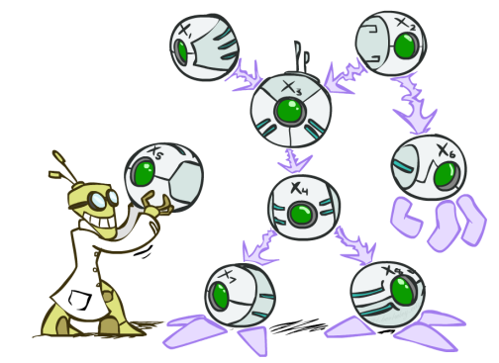
AI: Representation and Problem Solving
Bayes Nets
Instructors: Pat Virtue & Stephanie Rosenthal
Slide credits: CMU AI and http://ai.berkeley.edu

Slide 4
AI-pril Fool’s!
Trouble maker credit: Arnav & Pranav

Slide 5
Course Survey
Please fill out on Piazza!

Slide 6
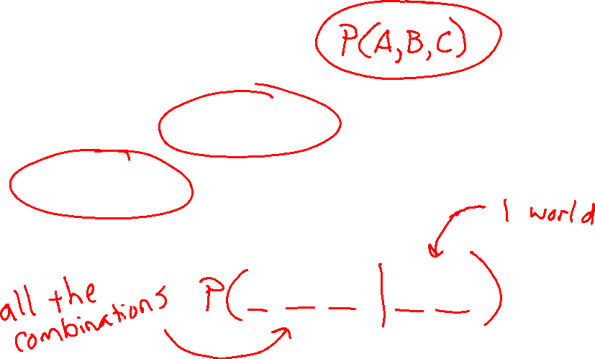
Warm-up as you walk in
When does a probability table sum to 1?
$P(c∣A)$
$P(A, B, c)$
$P(a∣B, C)$
$P(A∣b)$
$P(A, B∣c)$
$P(a, b∣c)$

Slide 7



Answer Any Query from Joint Distribution
What is the probability of getting a slice with:
No mushrooms
Spinach and no mushrooms
Spinach, when asking for slice with no mushrooms
Mushrooms
Spinach
No spinach
No spinach and mushrooms
No spinach when asking for no mushrooms
No spinach when asking for mushrooms
Spinach when asking for mushrooms
No mushrooms and no spinach
Icons: CC, https://openclipart.org/detail/296791/pizza-slice

Slide 8


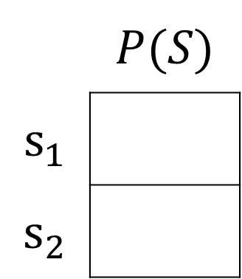
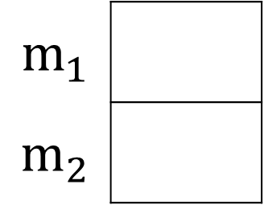

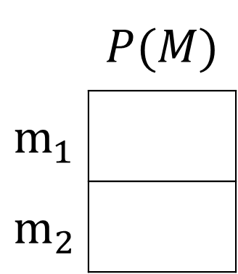


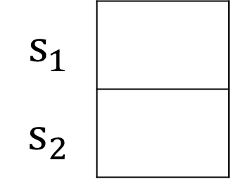
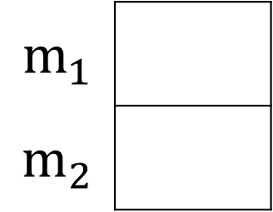


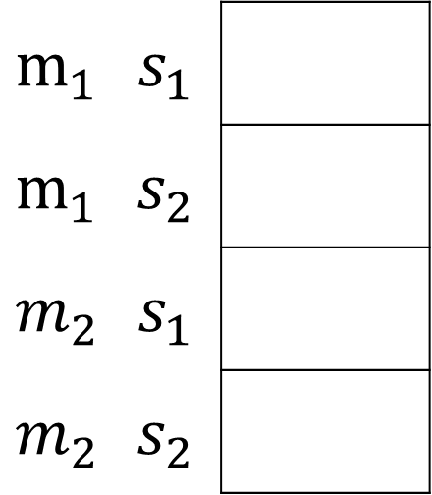
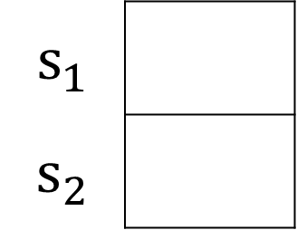

Answer Any Query from Joint Distribution
You can answer all of these questions:
$P(M|s_{1})$
$P(M|s_{2})$
 | $$P(M)$$
$$m_{1}$$
$$m_{2}$$
$P(M,S)$
$$m_{1}$$
$$m_{2}$$
$$m_{1}$$
$$m_{2}$$
$$12/20$$
$$m_{1}$$ | $$s_{1}$$
$$m_{1}$$ | $$s_{2}$$
$$m_{2}$$ | $$s_{1}$$
$$m_{2}$$ | $$s_{2}$$
$$6/20$$
$P(S|m_{1})$
$P(S|m_{2})$
 | $$P(S)$$
$$s_{1}$$
$$s_{2}$$
$$s_{1}$$
$$s_{2}$$
$$s_{1}$$
$$s_{2}$$
$$6/12$$

Slide 9
Answer Any Query from Joint Distribution
P(Weather)?
P(Weather | winter)?
P(Weather | winter, hot)?
Season | Temp | Weather | P(S, T, W)
summer | hot | sun | 0.30
summer | hot | rain | 0.05
summer | cold | sun | 0.10
summer | cold | rain | 0.05
winter | hot | sun | 0.10
winter | hot | rain | 0.05
winter | cold | sun | 0.15
winter | cold | rain | 0.20

Slide 10
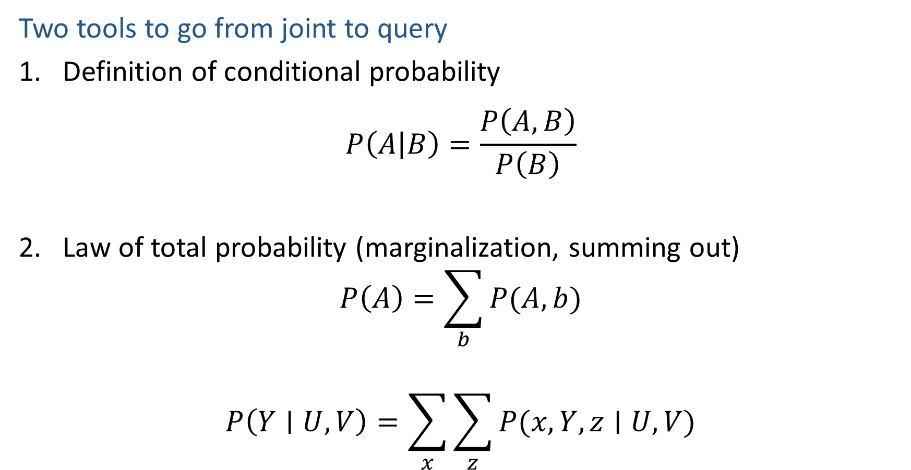

Answer Any Query from Joint Distribution
Two tools to go from joint to query
Definition of conditional probability
$$P\left(A | B\right)=\frac{P\left(A,B\right)}{P\left(B\right)}$$
Law of total probability (marginalization, summing out)
$$P\left(A\right)=\sum_{b}{P(A,b)}$$
$$P\left(Y∣U, V\right)=\sum_{x}{\sum_{z}{P(x, Y, z∣U, V)}}$$

Slide 11
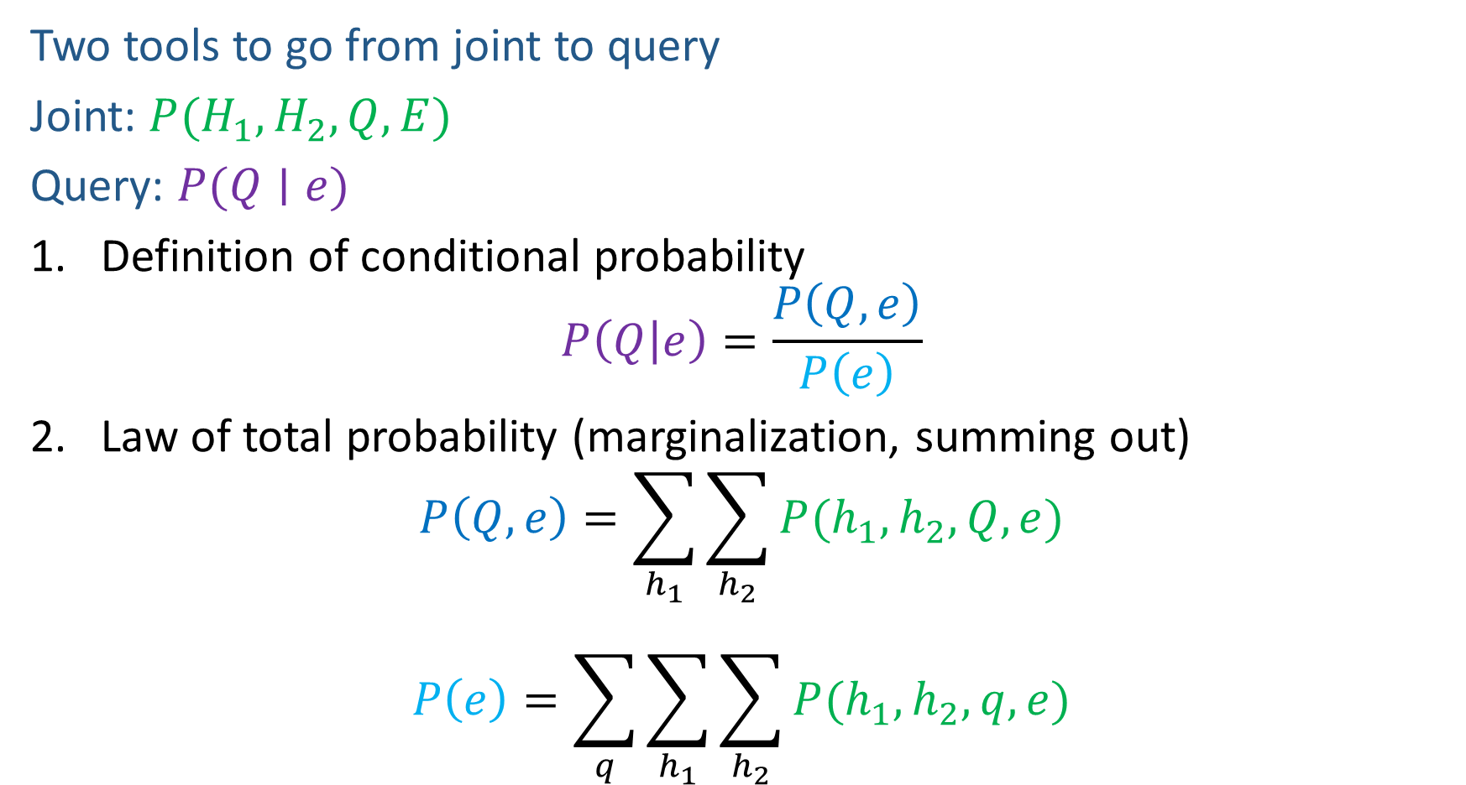

Answer Any Query from Joint Distribution
Two tools to go from joint to query
Joint: $P(H_{1}, H_{2}, Q, E)$
Query: $P(Q∣e)$
Definition of conditional probability
$$P\left(Q | e\right)=\frac{P\left(Q,e\right)}{P\left(e\right)}$$
Law of total probability (marginalization, summing out)
$$P\left(Q,e\right)=\sum_{h_{1}}{\sum_{h_{2}}{P(h_{1},h_{2},Q, e)}}$$
$$P\left(e\right)=\sum_{q}{\sum_{h_{1}}{\sum_{h_{2}}{P(h_{1},h_{2}, q,e)}}}$$

Slide 12
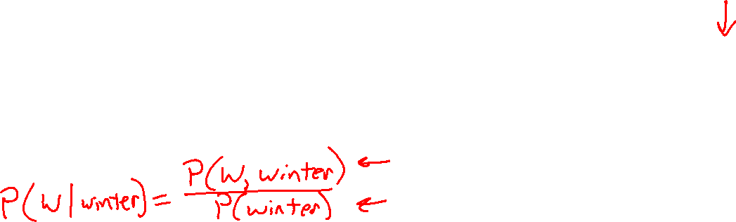
Answer Any Query from Joint Distribution
P(Weather)?
P(Weather | winter)?
P(Weather | winter, hot)?
Season | Temp | Weather | P(S, T, W)
summer | hot | sun | 0.30
summer | hot | rain | 0.05
summer | cold | sun | 0.10
summer | cold | rain | 0.05
winter | hot | sun | 0.10
winter | hot | rain | 0.05
winter | cold | sun | 0.15
winter | cold | rain | 0.20

Slide 13
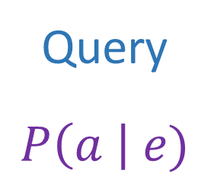
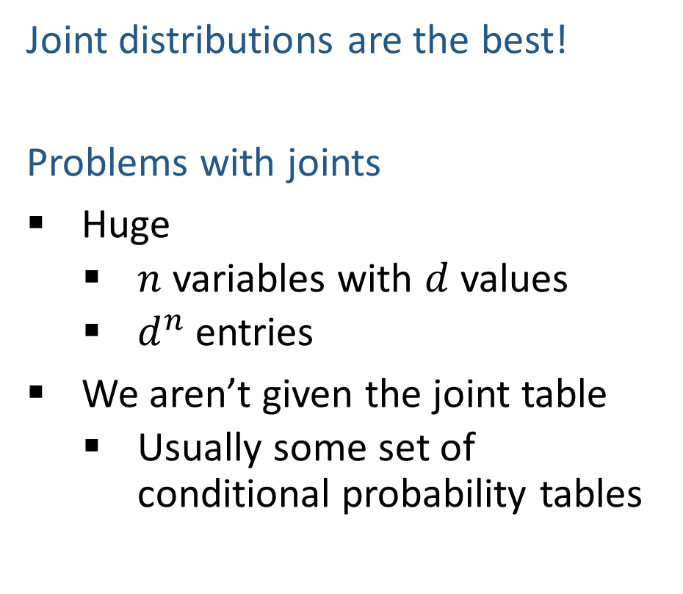
Answer Any Query from Joint Distribution
Joint distributions are the best!
Problems with joints
Huge
$n$ variables with $d$ values
$d^{n}$ entries
We aren’t given the joint table
Usually some set of conditional probability tables
Joint
Query
$$P\left(a \right| e)$$

Slide 14
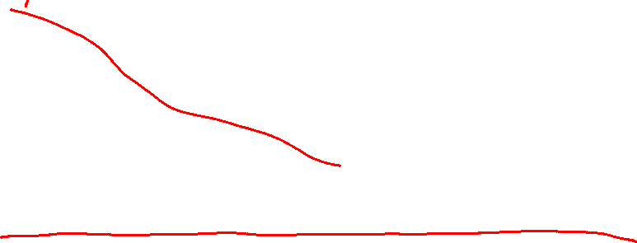
Build Joint Distribution Using Chain Rule
Conditional Probability Tables and Chain Rule
Joint
Query
$$P\left(a \right| e)$$
$P\left(A\right) P\left(B | A\right) P\left(C | A,B\right) P\left(D | A,B,C\right)$ $P(E|A, B,C,D)$

Slide 15
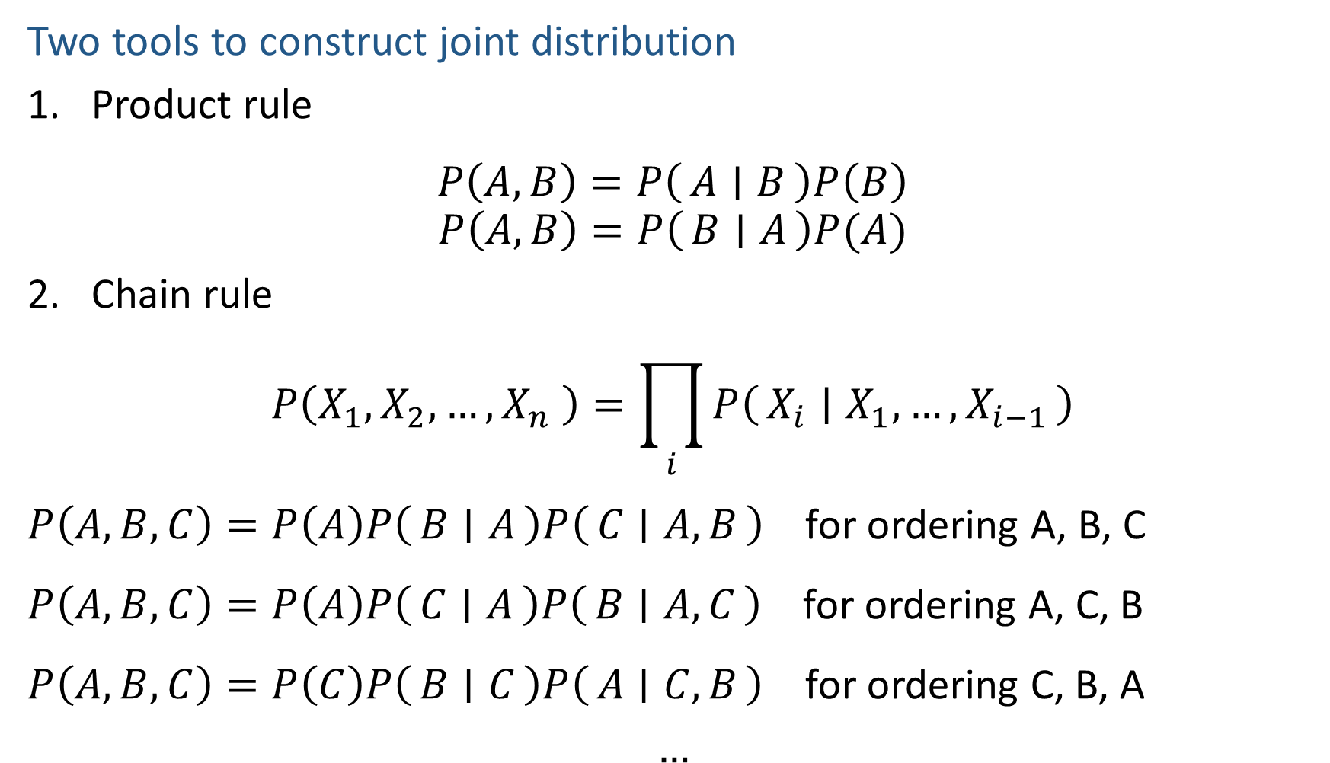

Build Joint Distribution Using Chain Rule
Two tools to construct joint distribution
Product rule
$$P\left(A,B\right)=P\left(A ∣ B\right)P\left(B\right)$$
$$P\left(A,B\right)=P\left(B ∣ A\right)P(A)$$
Chain rule
$$P\left(X_{1},X_{2},…,X_{n} \right)=\prod_{i}{P\left(X_{i} ∣ X_{1},…,X_{i−1}\right)}$$
$P\left(A,B,C\right)=P\left(A\right)P\left(B ∣ A\right)P\left(C ∣ A, B\right)$ for ordering A, B, C
$P\left(A,B,C\right)=P\left(A\right)P\left(C ∣ A\right)P\left(B ∣ A,C\right)$ for ordering A, C, B
$P\left(A,B,C\right)=P\left(C\right)P\left(B ∣ C\right)P\left(A ∣ C,B\right)$ for ordering C, B, A
$$…$$

Slide 16
Answer Any Query from Condition Probability Tables
Conditional Probability Tables and Chain Rule
Joint
Query
$$P\left(a \right| e)$$
$P\left(A\right) P\left(B | A\right) P\left(C | A,B\right) P\left(D | A,B,C\right)$ $P(E|A, B,C,D)$

Slide 17

Answer Any Query from Condition Probability Tables
Process to go from (specific) conditional probability tables to query
Construct the joint distribution
Product Rule or Chain Rule
Answer query from joint
Definition of conditional probability
Law of total probability (marginalization, summing out)

Slide 18
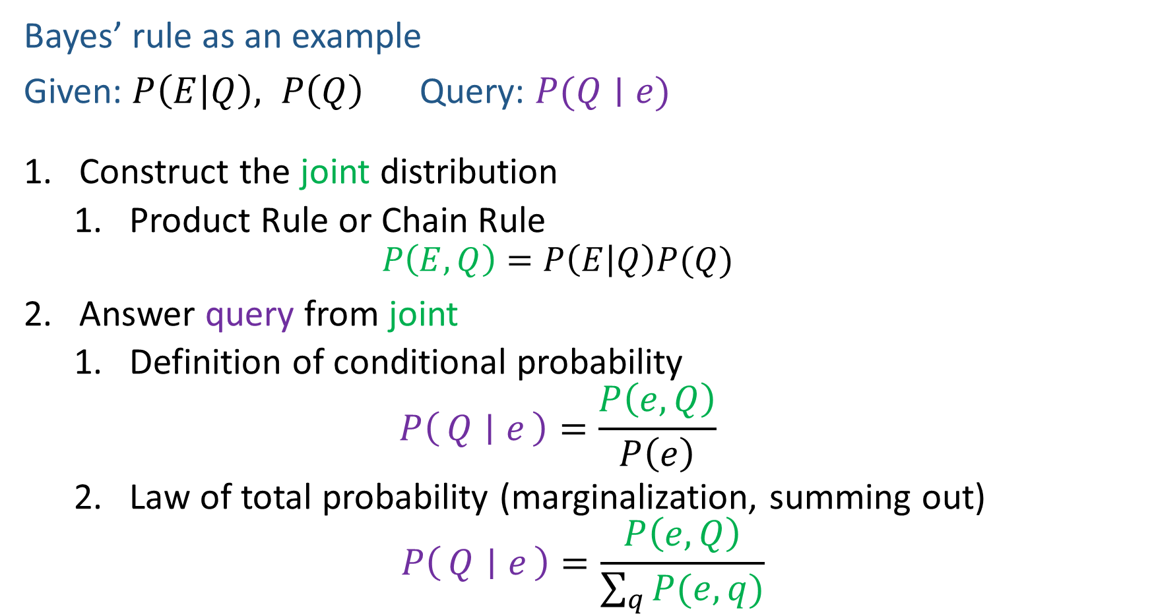

Answer Any Query from Condition Probability Tables
Bayes’ rule as an example
Given: $P\left(E | Q\right), P\left(Q\right)$ Query: $P(Q∣e)$
Construct the joint distribution
Product Rule or Chain Rule
$$P\left(E,Q\right)=P\left(E | Q\right)P(Q)$$
Answer query from joint
Definition of conditional probability
$$P\left(Q ∣ e\right)=\frac{P\left(e, Q\right)}{P\left(e\right)}$$
Law of total probability (marginalization, summing out)
$$P\left(Q ∣ e\right)=\frac{P\left(e, Q\right)}{\sum_{q}{P(e,q)}}$$

Slide 19
Answer Any Query from Condition Probability Tables
Conditional Probability Tables and Chain Rule
Joint
Query
$$P\left(a \right| e)$$
$P\left(A\right) P\left(B | A\right) P\left(C | A,B\right) P\left(D | A,B,C\right)$ $P(E|A, B,C,D)$

Slide 20
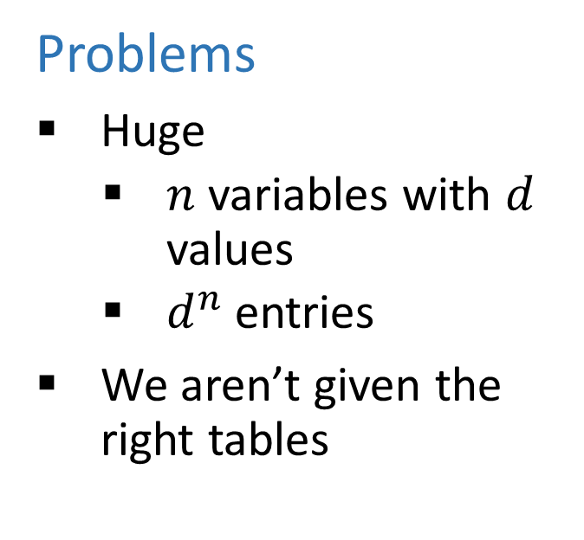
Answer Any Query from Condition Probability Tables
Conditional Probability Tables and Chain Rule
Problems
Huge
$n$ variables with $d$ values
$d^{n}$ entries
We aren’t given the right tables
$P\left(A\right) P\left(B | A\right) P\left(C | A,B\right) P\left(D | A,B,C\right)$ $P(E|A, B,C,D)$

Slide 21
Answer Any Query from Condition Probability Tables
Conditional Probability Tables and Chain Rule
Joint
Query
$$P\left(a \right| e)$$
$P\left(A\right) P\left(B | A\right) P\left(C | A,B\right) P\left(D | A,B,C\right)$ $P(E|A, B,C,D)$

Slide 22
Answer Any Query from Condition Probability Tables
Bayes Net
Joint
Query
$$P\left(a \right| e)$$
$$P\left(A\right) P\left(B | A\right) P\left(C | A\right) P\left(D | C\right) P(E|C)$$

Slide 23
Answer Any Query from Condition Probability Tables
Bayes Net
Query
$$P\left(a \right| e)$$
$$P\left(A\right) P\left(B | A\right) P\left(C | A\right) P\left(D | C\right) P(E|C)$$

Slide 24
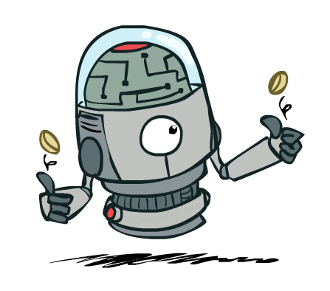
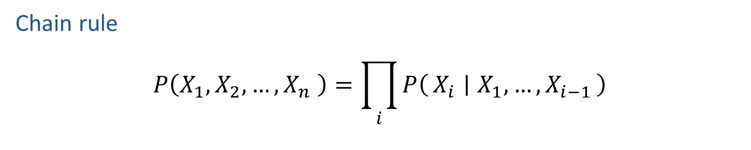
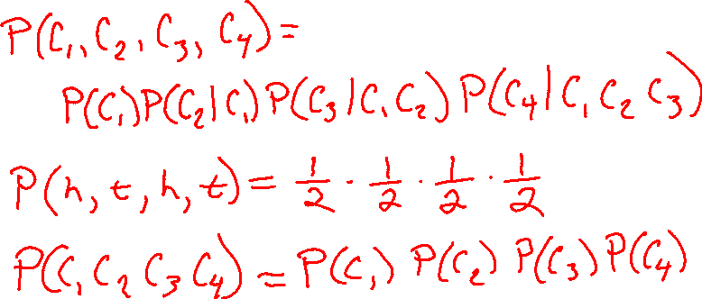
Build Joint Distribution Using Chain Rule
Chain rule
$$P\left(X_{1},X_{2},…,X_{n} \right)=\prod_{i}{P\left(X_{i} ∣ X_{1},…,X_{i−1}\right)}$$

Slide 25
Independence

Slide 26

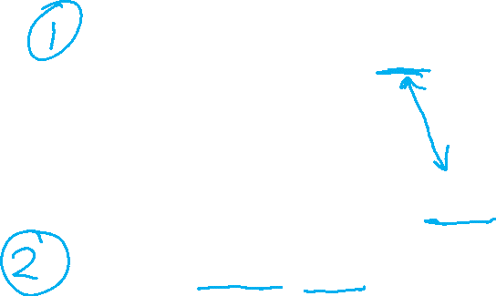
Independence
Two variables X and Y are (absolutely) independent if
∀x,y P(x, y) = P(x) P(y)
This says that their joint distribution factors into a product of two simpler distributions
Combine with product rule P(x,y) = P(x|y)P(y) we obtain another form:
∀x,y P(x | y) = P(x) or ∀x,y P(y | x) = P(y)
Example: two dice rolls Roll₁ and Roll₂
P(Roll₁=5, Roll₂=5) = P(Roll₁=5) P(Roll₂=5) = 1/6 x 1/6 = 1/36
P(Roll₂=5 | Roll₁=5) = P(Roll₂=5)

Slide 27


Example: Independence
n fair, independent coin flips:
P(X₁)
P(X₂)
P(X_{n})
H | 0.5
T | 0.5
H | 0.5
T | 0.5
H | 0.5
T | 0.5
P(X₁,X₂,...,X_{n})
2^{n}

Slide 28

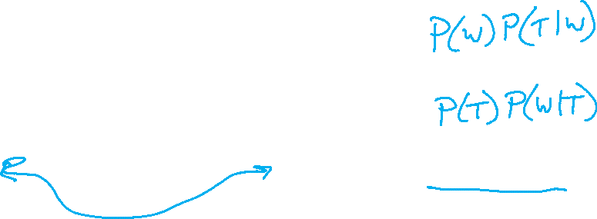



Example: Independence?
$$P(T)$$
T | P
hot | 0.5
cold | 0.5
$$P_{1}\left(T,W\right)$$
$P_{2}\left(T,W\right)=P\left(T\right)P(W)$
T | W | P
hot | sun | 0.4
hot | rain | 0.1
cold | sun | 0.2
cold | rain | 0.3
T | W | P
hot | sun | 0.3
hot | rain | 0.2
cold | sun | 0.3
cold | rain | 0.2
$$P(W)$$
W | P
sun | 0.6
rain | 0.4

Slide 29
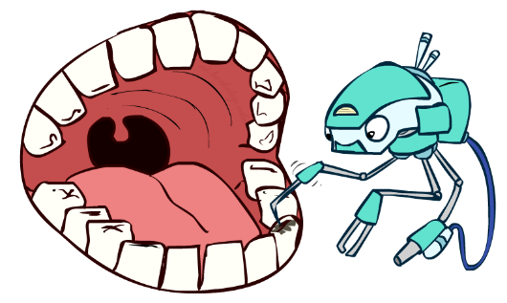
Conditional Independence
P(Toothache, Cavity, Catch)
If I have a cavity, the probability that the probe catches in it doesn't depend on whether I have a toothache:
P(+catch | +toothache, +cavity) = P(+catch | +cavity)
The same independence holds if I don’t have a cavity:
P(+catch | +toothache, -cavity) = P(+catch| -cavity)
Catch is conditionally independent of Toothache given Cavity:
P(Catch | Toothache, Cavity) = P(Catch | Cavity)
Equivalent statements:
P(Toothache | Catch , Cavity) = P(Toothache | Cavity)
P(Toothache, Catch | Cavity) = P(Toothache | Cavity) P(Catch | Cavity)
One can be derived from the other easily

Slide 30
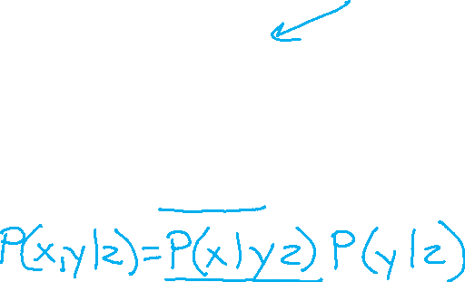
Conditional Independence
Unconditional (absolute) independence very rare (why?)
Conditional independence is our most basic and robust form of knowledge about uncertain environments.
X is conditionally independent of Y given Z
if and only if:
∀x,y,z P(x | y, z) = P(x | z)
or, equivalently, if and only if
∀x,y,z P(x, y | z) = P(x | z) P(y | z)

Slide 31
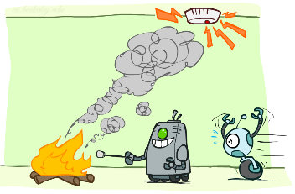
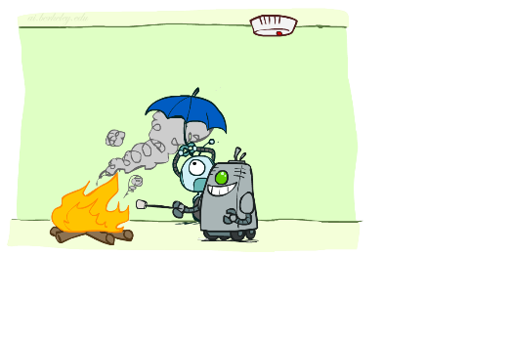
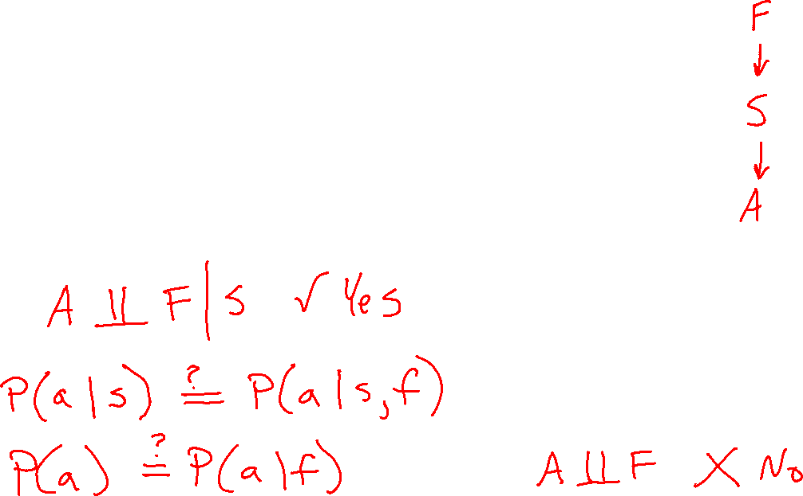
Conditional Independence
What about this domain:
Fire
Smoke
Alarm

Slide 32
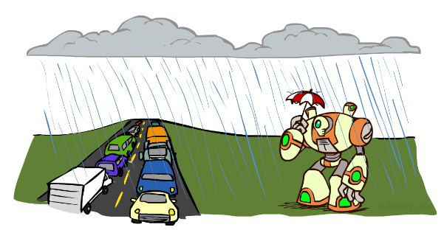
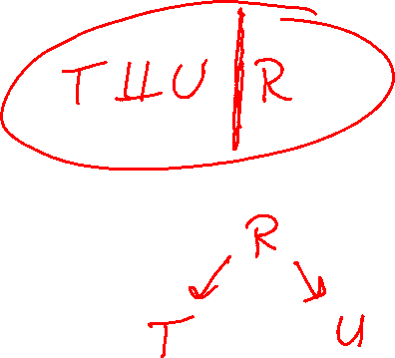
Conditional Independence
What about this domain:
Traffic
Umbrella
Raining

Slide 33

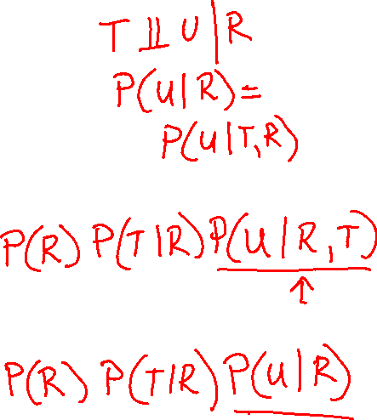
Conditional Independence and the Chain Rule
Chain rule:
P(x₁, x₂,…, x_{n}) = ∏_{i} P(x_{i} | x₁,…, x_{i-1})
Trivial decomposition:
P(Rain, Traffic, Umbrella) =
With assumption of conditional independence:
P(Rain, Traffic, Umbrella) =
Notes:
Will be obvious from ghostbusters example

Slide 34
Conditional Independence and the Chain Rule
Chain rule:
P(x₁, x₂,…, x_{n}) = ∏_{i} P(x_{i} | x₁,…, x_{i-1})
Trivial decomposition:
P(Rain, Traffic, Umbrella) = P(Rain) P(Traffic | Rain) P(Umbrella | Rain, Traffic)
With assumption of conditional independence:
P(Rain, Traffic, Umbrella) = P(Rain) P(Traffic | Rain) P(Umbrella | Rain)
Bayes nets / graphical models help us express conditional independence assumptions
Notes:
Will be obvious from ghostbusters example

Slide 35

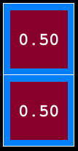
Ghostbusters Chain Rule
Each sensor depends only on where the ghost is
That means, the two sensors are conditionally independent, given the ghost position
T: Top square is red B: Bottom square is red G: Ghost is in the top
Givens:
P( +g ) = 0.5
P( -g ) = 0.5
P( +t | +g ) = 0.8 P( +t | -g ) = 0.4 P( +b | +g ) = 0.4 P( +b | -g ) = 0.8
P(T,B,G) = P(G) P(T|G) P(B|G)
T | B | G | P(T,B,G)
+t | +b | +g | 0.16
+t | +b | -g | 0.16
+t | -b | +g | 0.24
+t | -b | -g | 0.04
-t | +b | +g | 0.04
-t | +b | -g | 0.24
-t | -b | +g | 0.06
-t | -b | -g | 0.06

Slide 36
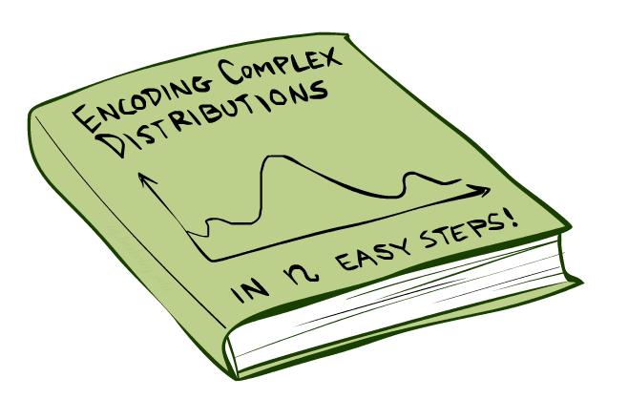
Bayes’Nets: Big Picture

Slide 37

Bayes’ Nets: Big Picture
Two problems with using full joint distribution tables as our probabilistic models:
Unless there are only a few variables, the joint is WAY too big to represent explicitly
Hard to learn (estimate) anything empirically about more than a few variables at a time
Bayes’ nets: a technique for describing complex joint distributions (models) using simple, local distributions (conditional probabilities)
More properly called graphical models
We describe how variables locally interact
Local interactions chain together to give global, indirect interactions

Slide 38
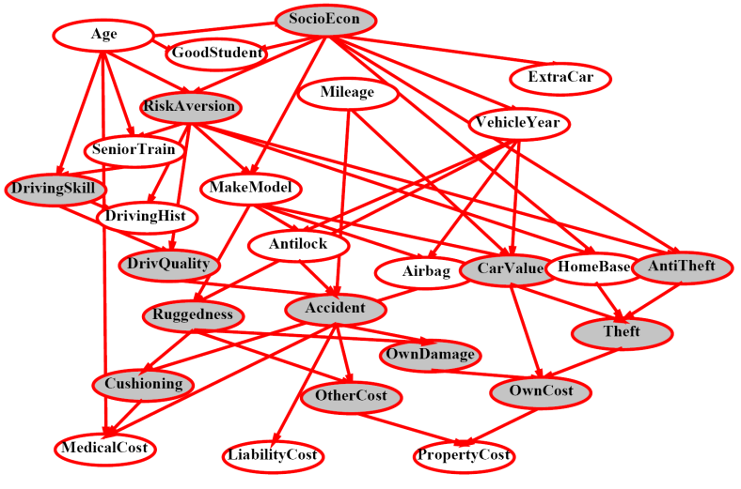
Example Bayes’ Net: Insurance

Slide 39
Example Bayes’ Net: Car

Slide 40
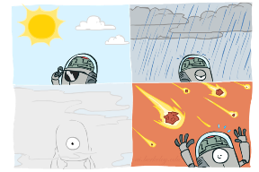
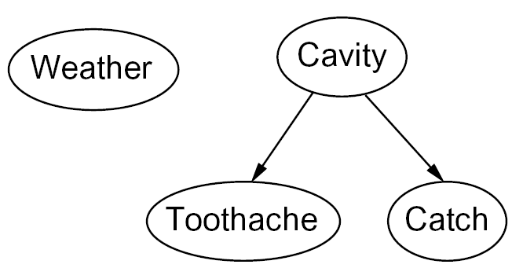

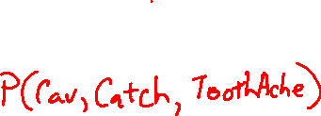
Graphical Model Notation
Nodes: variables (with domains)
Can be assigned (observed) or unassigned (unobserved)
Arcs: interactions
Similar to CSP constraints
Indicate “direct influence” between variables
Formally: encode conditional independence (more later)
For now: imagine that arrows mean direct causation (in general, they don’t!)

Slide 41

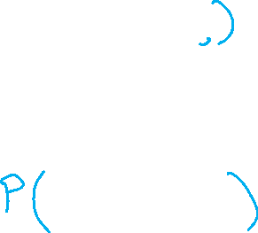
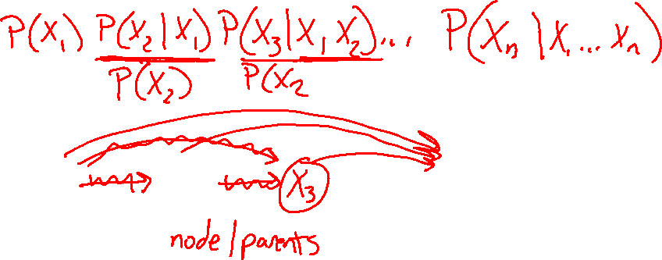

Example: Coin Flips
N independent coin flips
No interactions between variables: absolute independence
X₁
X₂
X_{n}

Slide 42
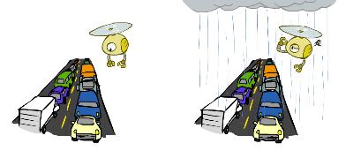
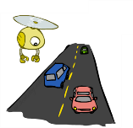

Example: Traffic
Variables:
R: It rains
T: There is traffic
Model 1: independence
Why is an agent using model 2 better?
Model 2: rain causes traffic
R
R
T
T

Slide 43
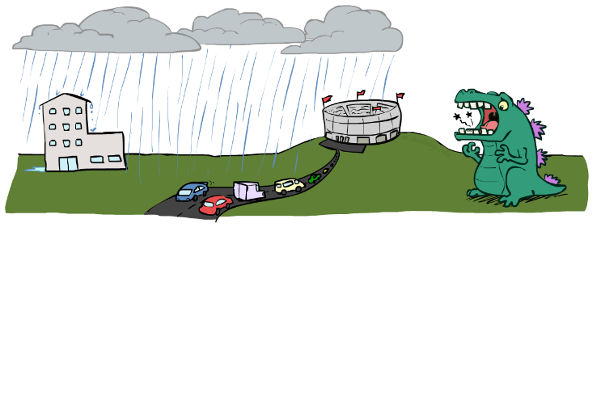

Example: Traffic II
Let’s build a causal graphical model!
Variables
T: Traffic
R: It rains
L: Low pressure
D: Roof drips
B: Ballgame
C: Cavity

Slide 44
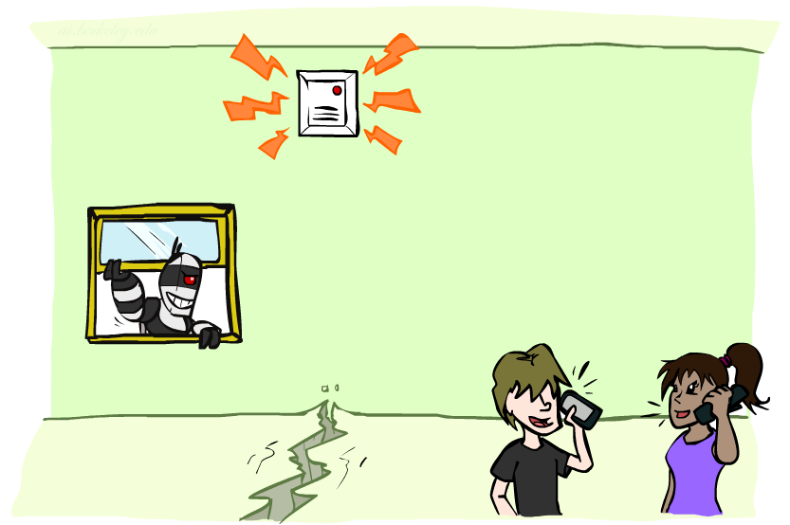
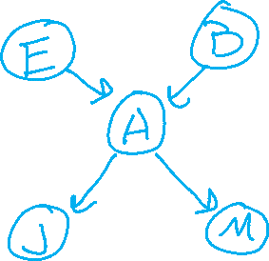
Example: Alarm Network
Variables
B: Burglary
A: Alarm goes off
M: Mary calls
J: John calls
E: Earthquake!

Slide 45
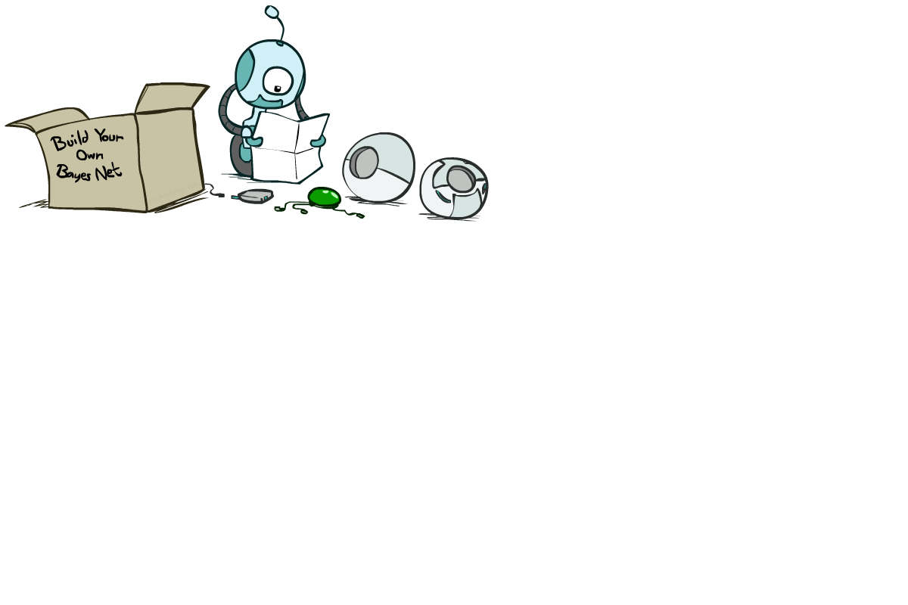
Bayes’ Net Semantics

Slide 46





Bayes Nets Syntax Review
One node per random variable
DAG
One CPT per node: P(node | Parents(node) )
Bayes net
$$A$$
$$B$$
$$C$$
$$D$$
$$E$$

Slide 47
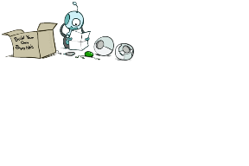
Bayes Net Global Semantics
Bayes nets:
Encode joint distributions as product of conditional distributions on each variable
$$P\left(X_{1}…X_{2}\right)=\prod_{i}{P\left(X_{i}\right| Parents(X_{i})) }$$

Slide 48
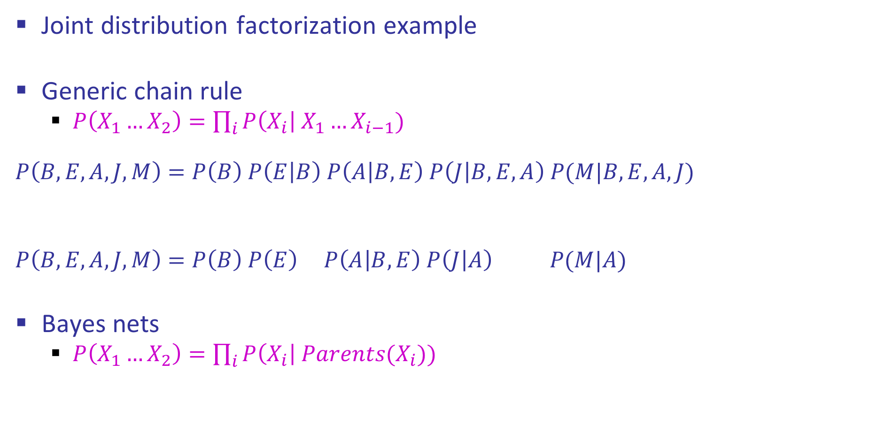
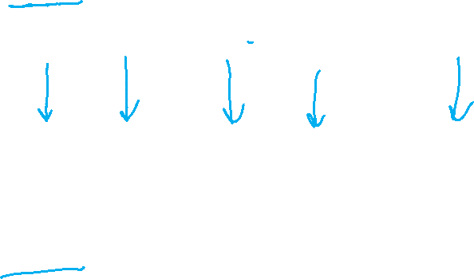
Semantics Example
Joint distribution factorization example
Generic chain rule
$P\left(X_{1}…X_{2}\right)=\prod_{i}{P\left(X_{i}\right| X_{1}…X_{i−1}) }$
$$P\left(B,E,A,J,M\right)=P\left(B\right) P\left(E | B\right) P\left(A | B,E\right) P\left(J | B,E,A\right) P(M|B,E,A,J)$$
$$P\left(B,E,A,J,M\right)=P\left(B\right) P\left(E\right) P\left(A | B,E\right) P\left(J | A\right) P(M|A)$$
Bayes nets
$P\left(X_{1}…X_{2}\right)=\prod_{i}{P\left(X_{i}\right| Parents(X_{i})) }$
Burglary
Earthquake
Alarm
John calls
Mary calls

Slide 49

Example: Coin Flips
X₁
X₂
X_{n}
h | 0.5
t | 0.5
h | 0.5
t | 0.5
h | 0.5
t | 0.5
Only distributions whose variables are absolutely independent can be represented by a Bayes’ net with no arcs.
Notes:
demo

Slide 50

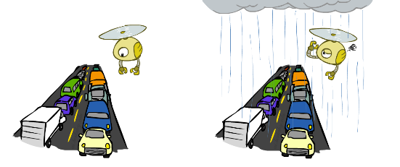

Example: Traffic
R
+r | 1/4
-r | 3/4
+r | +t | 3/4
 | -t | 1/4
T
-r | +t | 1/2
 | -t | 1/2
Notes:
demo

Slide 51
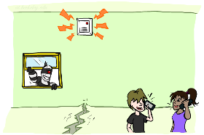
Example: Alarm Network
B | P(B)
+b | 0.001
-b | 0.999
E | P(E)
+e | 0.002
-e | 0.998
Burglary
Earthqk
Alarm
B | E | A | P(A|B,E)
+b | +e | +a | 0.95
+b | +e | -a | 0.05
+b | -e | +a | 0.94
+b | -e | -a | 0.06
-b | +e | +a | 0.29
-b | +e | -a | 0.71
-b | -e | +a | 0.001
-b | -e | -a | 0.999
John calls
Mary calls
A | J | P(J|A)
+a | +j | 0.9
+a | -j | 0.1
-a | +j | 0.05
-a | -j | 0.95
A | M | P(M|A)
+a | +m | 0.7
+a | -m | 0.3
-a | +m | 0.01
-a | -m | 0.99
Notes:
demo

